Slide 1
Search
Update a Cookbook to Dynamically Use Nodes with the Web Role

Slide 2
Objectives
After completing this module, you should be able to
Describe the query syntax used in search
Build a search into your recipe code
Update the wrapped proxy cookbook to dynamically use nodes with the web role

Slide 3
Search
So far we have seen how Chef is able to manage the policy of the nodes.
We have two web servers and one proxy server.
Notes:
So far we have seen how Chef is able to manage the policy of the nodes within our infrastructure.
We have two web servers and one proxy server. As more customers come to our website we can continue scale up to meet that demand.

Slide 4
Search
To add new servers as proxy members, we would need to bootstrap a new web server and then update our proxy cookbook's recipe.
That seems inefficient to have to update a cookbook recipe.
Notes:
To add new servers as proxy members, we would need to bootstrap a new web server and then update our proxy cookbook's recipe to include that new web server. But that seems dramatically inefficient to have to update a cookbook recipe.
A more ideal solution would be for the recipe to instead discover all of the web servers within our organization and automatically add them list of available members for our proxy.

Slide 5

The Chef Server and Search
Chef Server maintains a representation of all the nodes within our infrastructure that can be searched on.
Search is a service discovery tool that allows us to query the Chef Server.
Web Nodes Node 1 Node 3 Node 8 | Proxy Nodes Node 2 Node 5 Node 6
Chef Server
https://docs.chef.io/chef_search.html
https://docs.chef.io/chef_search.html#search-indexes
Notes:
The Chef Server maintains a representation of all the nodes within an infrastructure and provides a way for us to discover these systems through Search.
Search is a service discovery tool that allows us to query the Chef Server across a few indexes. One such index is on our nodes.

Slide 6
The Chef Server and Search
We can ask the Chef Server to return all the nodes or a subset of nodes based on the query syntax that we provide it through `knife search` or within our recipes through `search`.
Web Nodes Node 1 Node 3 Node 8 | Proxy Nodes Node 2 Node 5 Node 6
Chef Server
Notes:
We can ask the Chef Server to return back to us all the nodes or a subset of nodes based on the query syntax that we provide it through the knife command `knife search` or within our recipes through `search`.

Slide 7

Search Criteria
The search criteria that we have been using up to this point is "*:*"
Querying and returning every node is not what we need to solve our current problem.
Scenario: We want only to return a subset of our nodes--only the nodes that are webservers.
Notes:
We have been using a form of the search criteria already when we have employed the `knife ssh` command. The search criteria that we have been using up to this point is "*:*" which we explained matched every node within our infrastructure.
Querying and returning every node is not exactly what need to solve our current problem. Scenario: We want only to return a subset of our nodes--only the nodes that are webservers.
Let's examine the search criteria more so we can understand how it works and how we can use it to find a subset of the nodes--only the nodes that are webservers.

Slide 8
Search
A search can be done from several locations, including:
From within a recipe.
By using the search subcommand in knife.
Using the /search or /search/INDEX endpoints in the Chef server API.
Etc.
In this module we will focus on using Search from within a recipe.
Notes:
A search is a full-text query that can be done from several locations, including from within a recipe, using the /search or /search/INDEX endpoints in the Chef server API, and other methods.
In this module we will focus on using Search from within a recipe.

Slide 9
Search Syntax
A search query is comprised of two parts: the key and the search pattern. A search query has the following syntax:
key:search_pattern
...where key is a field name that is found in the JSON description of an indexable object on the Chef server and search_pattern defines what will be searched for,
Notes:
A search query is comprised of two parts: the key and the search pattern. A search query has the following syntax:
key:search_pattern
...where key is a field name that is found in the JSON description of an indexable object on the Chef server (a role, node, client, environment, or data bag) and search_pattern defines what will be searched for.

Slide 10
Search Syntax within a Recipe
all_web_nodes = search("node","role:web")
Notes:
TBD: Need explanation...

Slide 11
Hard Coding Example
~/chef-repo/cookbooks/myhaproxy/default.rb
node.default['haproxy']['members'] = [{
"hostname" => "ec2-204-236-155-223.us-west-1.compute.amazonaws.com",
"ipaddress" => "ec2-204-236-155-223.us-west-1.compute.amazonaws.com",
"port" => 80,
"ssl_port" => 80
},
{
"hostname" => "ec2-54-176-64-173.us-west-1.compute.amazonaws.com",
"ipaddress" => "ec2-54-176-64-173.us-west-1.compute.amazonaws.com",
"port" => 80,
"ssl_port" => 80
}
]
include_recipe "haproxy::default"
Notes:
Previously, we had been hard coding the hostname and ipaddress values in our wrapped haproxy recipe. We can request these values from the Chef Server through the `knife node show` command.
The hostname and ipaddress values are captured by Ohai and sent to the Chef Server. On the Chef Server we can query those values when we ask about specific attribute about the node.
We do that by providing the `-a` flag with the name of the attribute. Because the nodes that we manage are hosted in the cloud, these attributes are stored under a parent attribute named 'cloud'.

Slide 12
GE: Dynamic Web Proxy
Every time we create a web node we need to update our proxy cookbook. That doesn't feel right!
Update the wrapped proxy cookbook to dynamically use nodes with the web role
Notes:
In this section we'll update the wrapped proxy cookbook to dynamically use nodes with the web role.

Slide 13
GE: Showing node1 Cloud Attributes
$ knife node show node1 -a cloud
node1:
cloud:
local_hostname: ip-10-198-51-26.us-west-1.compute.internal
local_ipv4: 10.198.51.26
private_ips: 10.198.51.26
provider: ec2
public_hostname: ec2-204-236-155-223.us-west-1.compute.amazonaws.com
public_ips: 204.236.155.223
public_ipv4: 204.236.155.223
Notes:
Here we are asking for all the 'cloud' attributes for 'node1'.

Slide 14
GE: Showing node3 Cloud Attributes
$ knife node show node3 -a cloud
node3:
cloud:
local_hostname: ip-10-197-105-148.us-west-1.compute.internal
local_ipv4: 10.197.105.148
private_ips: 10.197.105.148
provider: ec2
public_hostname: ec2-54-176-64-173.us-west-1.compute.amazonaws.com
public_ips: 54.176.64.173
public_ipv4: 54.176.64.173
Notes:
Here we are asking for all the 'cloud' attributes for 'node3'.

Slide 15
GE: Remove the Hard-coded Members
~/chef-repo/cookbooks/myhaproxy/default.rb
node.default['haproxy']['members'] = [{
"hostname" => "ec2-204-236-155-223.us-west-1.compute.amazonaws.com",
"ipaddress" => "ec2-204-236-155-223.us-west-1.compute.amazonaws.com",
"port" => 80,
"ssl_port" => 80
},
{
"hostname" => "ec2-54-176-64-173.us-west-1.compute.amazonaws.com",
"ipaddress" => "ec2-54-176-64-173.us-west-1.compute.amazonaws.com",
"port" => 80,
"ssl_port" => 80
}
]
include_recipe "haproxy::default"
Notes:
Edit the 'myhaproxy' cookbook's default recipe and remove the current default recipe where you hard-coded the members.

Slide 16
GE: Use Search to Identify the Members
~/chef-repo/cookbooks/myhaproxy/recipes/default.rb
all_web_nodes = search("node","role:web")
members = []
all_web_nodes.each do |web_node|
member = {
"hostname" => web_node["cloud"]["public_hostname"],
"ipaddress" => web_node["cloud"]["public_ipv4"],
"port" => 80,
"ssl_port" => 80
}
members.push(member)
end
node.default['haproxy']['members'] = members
include_recipe "haproxy::default"
Notes:
Replace it with an updated recipe that searches for all nodes that have the 'web' role defined.
The search method's first parameter is asking the Chef Server to look at all the nodes within our organization.
The search method's second parameter is asking the Chef Server to only return the nodes that have been assigned the role web.

Slide 17
Use Search to Identify the Members
~/chef-repo/cookbooks/myhaproxy/recipes/default.rb
all_web_nodes = search("node","role:web")
members = []
all_web_nodes.each do |web_node|
member = {
"hostname" => web_node["cloud"]["public_hostname"],
"ipaddress" => web_node["cloud"]["public_ipv4"],
"port" => 80,
"ssl_port" => 80
}
members.push(member)
end
node.default['haproxy']['members'] = members
include_recipe "haproxy::default"
Notes:
All of those nodes are stored in a local variable named `all_web_nodes`. This is an array of node objects. It may contain zero or more nodes that match the search criteria.
TBD: These node objects are not in the format that the haproxy members attribute expects to see so unfortunately we cannot simply assign the resulting array of nodes into the members.
We need to first convert every node returned from the search into a hash structured similarly to what we manually created.

Slide 18
TBD Creating a
"
Notes:
TBD Need array info?
First we create an empty array and assign that empty array into a local variable named `members`. `members` is an array that we will populated with the hashes we are about to create and we will assign that array into the `node.default['haproxy']['members']`.
So we need to loop through the array of all the web nodes stored in `all_web_nodes`. We do that through a method available on every array object named 'each'. With the each method a block of code is provided -- you see it here from the first 'do' right after the each to the 'end' later in the file.
A block of code is an operation that you want perform on every item in the array. In our case we want to take each of the node objects and convert them into a hash object.
So every member of the array is visited and every member of the array runs through the block of code.

Slide 19
TBD Creating a
"
Notes:
TBD
Between the pipes we see a local variable that we are defining that exists only in the block `web_node`. This local variable, `web_node`, is a name we came up with to refer to each node in our array of `all_web_nodes`.
Each web node in the array is sent through the block. When inside the block of code it is referred to as `web_node`.
Inside the block the first thing that is created is another local variable named `member` which is assigned a hash that contains the web_node's hostname and the web_node's ipaddress.
Then the local variable `member`, which contains that hash is pushed into the array of members. This adds the member to the end of the array.
When we are done looping through every web node the `members` array contains a list of all these hash objects.
We finally assign that newly created array to the same default haproxy member's attribute we had previously used.

Slide 20
Dynamic Web Proxy
Every time we create a web node we need to update our proxy cookbook. That doesn't feel right!
Update the wrapped proxy cookbook to dynamically use nodes with the web role
Notes:
The default recipe of the myhaproxy recipe is now dynamic. Every time a proxy server checks in with the Chef Server, when you run `chef-client`, it will ask the Chef Server if there are any new nodes that are web servers.
As you add nodes, your proxy server will dynamically grow to accommodate them, returning them as node objects, which are then converted to hashes, and then assigned as members.
As you remove nodes, your proxy server will dynamically shrink to accommodate them, returning a smaller set of node objects, which are then converted to hashes, and then assigned as members.

Slide 21
Lab: Upload the Cookbook
Update the major version of the proxy cookbook
Upload the proxy cookbook
Run chef-client on the proxy node
Verify that the proxy node relays requests to both web nodes
Notes:
As a lab exercise:
* Update the major version of the cookbook
* Update the cookbook to the Chef Server
* Run `chef-client` on the proxy node
* Verify that the proxy node still relays requests to both of our web servers

Slide 22
Lab: Update the Version Number
~/chef-repo/cookbooks/myhaproxy/metadata.rb
name 'myhaproxy'
maintainer 'The Authors'
maintainer_email 'you@example.com'
license 'all_rights'
description 'Installs/Configures myhaproxy'
long_description 'Installs/Configures myhaproxy'
version '1.0.0'
depends 'haproxy', '~> 1.6.6'
Notes:
First we update the version to the next major release. We set the version number to 1.0.0.

Slide 23
Lab: CD and Install Dependencies
$ cd ~/chef-repo/cookbooks/myhaproxy
$ berks install
Resolving cookbook dependencies...
Fetching 'myhaproxy' from source at .
Fetching cookbook index from https://supermarket.chef.io...
Using build-essential (2.2.3)
Using cpu (0.2.0)
Using haproxy (1.6.6)
Using myhaproxy (1.0.0) from source at .
Notes:
Change into the cookbook's directory and then install any new dependencies that your cookbook may need at version 1.0.0.
We have no new dependencies but this is required by berkshelf whenever you update the version of the cookbook.

Slide 24
Lab: Upload the Cookbook
$ berks upload
Uploaded build-essential (2.2.3) to: 'https://api.opscode.com:443/organizations/steveessentials2'
Uploaded cpu (0.2.0) to: 'https://api.opscode.com:443/organizations/steveessentials2'
Uploaded haproxy (1.6.6) to: 'https://api.opscode.com:443/organizations/steveessentials2'
Uploaded myhaproxy (1.0.0) to: 'https://api.opscode.com:443/organizations/steveessentials2'
PS C:\Users\sdelfante\chef-repo\cookbooks\myhaproxy>
Notes:
Upload the cookbook using the `berks upload` command.
TBD: Should this have said frozen? I had to force it.
PS C:\Users\sdelfante\chef-repo\cookbooks\myhaproxy> berks upload
Skipping build-essential (2.2.3) (frozen)
Skipping cpu (0.2.0) (frozen)
Skipping haproxy (1.6.6) (frozen)
Uploaded myhaproxy (1.0.0) to: 'https://api.opscode.com:443/organizations/steveessentials2'

Slide 25
Lab: Run the knife ssh Command
$ knife ssh "role:proxy" -x USER -P PWD "sudo chef-client"
ec2-54-210-192-12.compute-1.amazonaws.com Starting Chef Client, version 12.3.0
ec2-54-210-192-12.compute-1.amazonaws.com resolving cookbooks for run list: ["myhaproxy"]
ec2-54-210-192-12.compute-1.amazonaws.com Synchronizing Cookbooks:
ec2-54-210-192-12.compute-1.amazonaws.com - build-essential
ec2-54-210-192-12.compute-1.amazonaws.com - cpu
ec2-54-210-192-12.compute-1.amazonaws.com - haproxy
ec2-54-210-192-12.compute-1.amazonaws.com - myhaproxy
ec2-54-210-192-12.compute-1.amazonaws.com Compiling Cookbooks...
ec2-54-210-192-12.compute-1.amazonaws.com Converging 9 resources
ec2-54-210-192-12.compute-1.amazonaws.com Recipe: haproxy::install_package
ec2-54-210-192-12.compute-1.amazonaws.com * yum_package[haproxy] action install (up to date)
ec2-54-210-192-12.compute-1.amazonaws.com * directory[/etc/haproxy] action create (up to date)
ec2-54-210-192-12.compute-1.amazonaws.com * template[/etc/init.d/haproxy] action create (up to date)
ec2-54-210-192-12.compute-1.amazonaws.com Recipe: haproxy::default
ec2-54-210-192-12.compute-1.amazonaws.com * cookbook_file[/etc/default/haproxy] action create (up to date)
ec2-54-210-192-12.compute-1.amazonaws.com * haproxy_lb[admin] action create (up to date)
ec2-54-210-192-12.compute-1.amazonaws.com * haproxy_lb[http] action create (up to date)
ec2-54-210-192-12.compute-1.amazonaws.com * haproxy_lb[servers-http] action create (up to date)
ec2-54-210-192-12.compute-1.amazonaws.com * template[/etc/haproxy/haproxy.cfg] action create (up to date)
ec2-54-210-192-12.compute-1.amazonaws.com * service[haproxy] action enable (up to date)
ec2-54-210-192-12.compute-1.amazonaws.com * service[haproxy] action start (up to date)
ec2-54-210-192-12.compute-1.amazonaws.com
ec2-54-210-192-12.compute-1.amazonaws.com Running handlers:
ec2-54-210-192-12.compute-1.amazonaws.com Running handlers complete
ec2-54-210-192-12.compute-1.amazonaws.com Chef Client finished, 0/10 resources updated in 22.893315511 seconds
Notes:
Use `knife ssh` and ask only the nodes with the role 'proxy' to run `sudo chef-client`. This is more efficient than targeted all of the nodes as we did before and more accurate than targeting the node2 "name:node2".
This ensures that all nodes that are also proxy servers to check in with the Chef Server. Similar to how we are targeting only the web server nodes in the recipe.
TBD: Trim output.

Slide 26
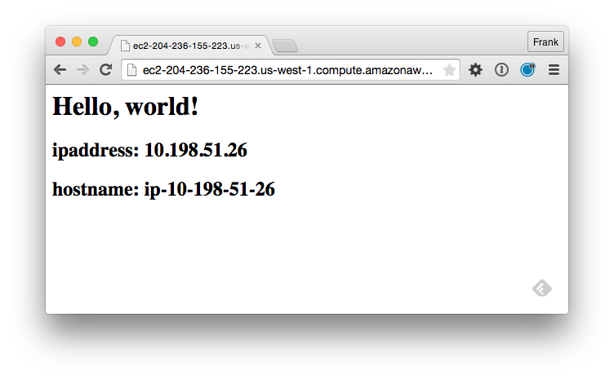

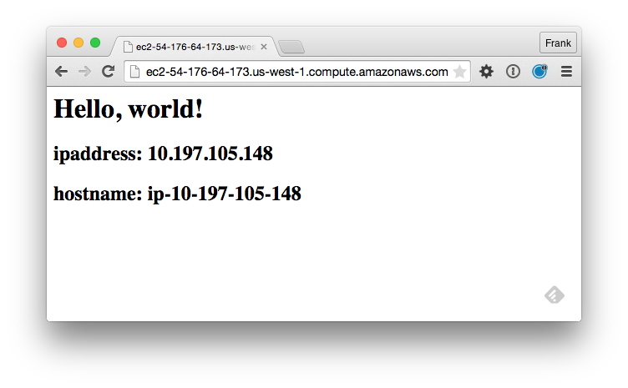
Notes:
Nothing should change externally. You may see some differences in the logs as the proxy configuration file might change the order of the two entries but the end results is that our proxy server node is still delivering traffic to our two web server nodes.

Slide 27


Slide 28
Discussion
What questions can we help you answer?

Slide 30
Search
Search indexes allow queries to be made for any type of data that is indexed by the Chef server.
Data like nodes, roles, and environments.
Notes:
TBD: Delete? Search indexes allow queries to be made for any type of data that is indexed by the Chef server, including environments, nodes, and roles.
A defined query syntax is used to support search patterns like exact, wildcard, range, and fuzzy.
A search is a full-text query that can be done from several locations, including from within a recipe, by using the search subcommand in knife, the search method in the Recipe DSL, the search box in the Chef management console, and by using the/search or /search/INDEX endpoints in the Chef server API. The search engine is based on Apache Solr and is run from the Chef server.
Many of the examples in this section use knife, but the search indexes and search query syntax can be used in many locations, including from within recipes and when using the Chef server API.

Slide 31
Search Syntax
Chef search uses the Solr 'key:search_pattern' syntax:
$ knife search node "ipaddress:10.20.30.40"
Use an asterisk ("*") for >=0 chars in a wildcard search:
$ knife search node "ipaddress:10.*"
$ knife search node "platfo*:centos"
Use a question mark ("?") to replace a single character
$ knife search node "platform_version:12.0?"
Notes:
TBD: Delete?
In this example-- $ knife search node "platfo*:centos"
-- platfor* could match "platform" or "platform_family"

Slide 32
Search Syntax
Chef search uses the Solr 'key:search_pattern' syntax:
$ knife search node "ipaddress:10.20.30.40"
Use an asterisk ("*") for >=0 chars in a wildcard search:
$ knife search node "ipaddress:10.*"
$ knife search node "platfo*:centos"
Use a question mark ("?") to replace a single character
$ knife search node "platform_version:12.0?"
https://docs.chef.io/chef_search.html#query-syntax
Notes:
TBD: Replace this slide? with how to search and searching by 'key:value'.
https://docs.chef.io/chef_search.html#query-syntax
In this example-- $ knife search node "platfo*:centos"
-- platfor* could match "platform" or "platform_family"

